Slide 1
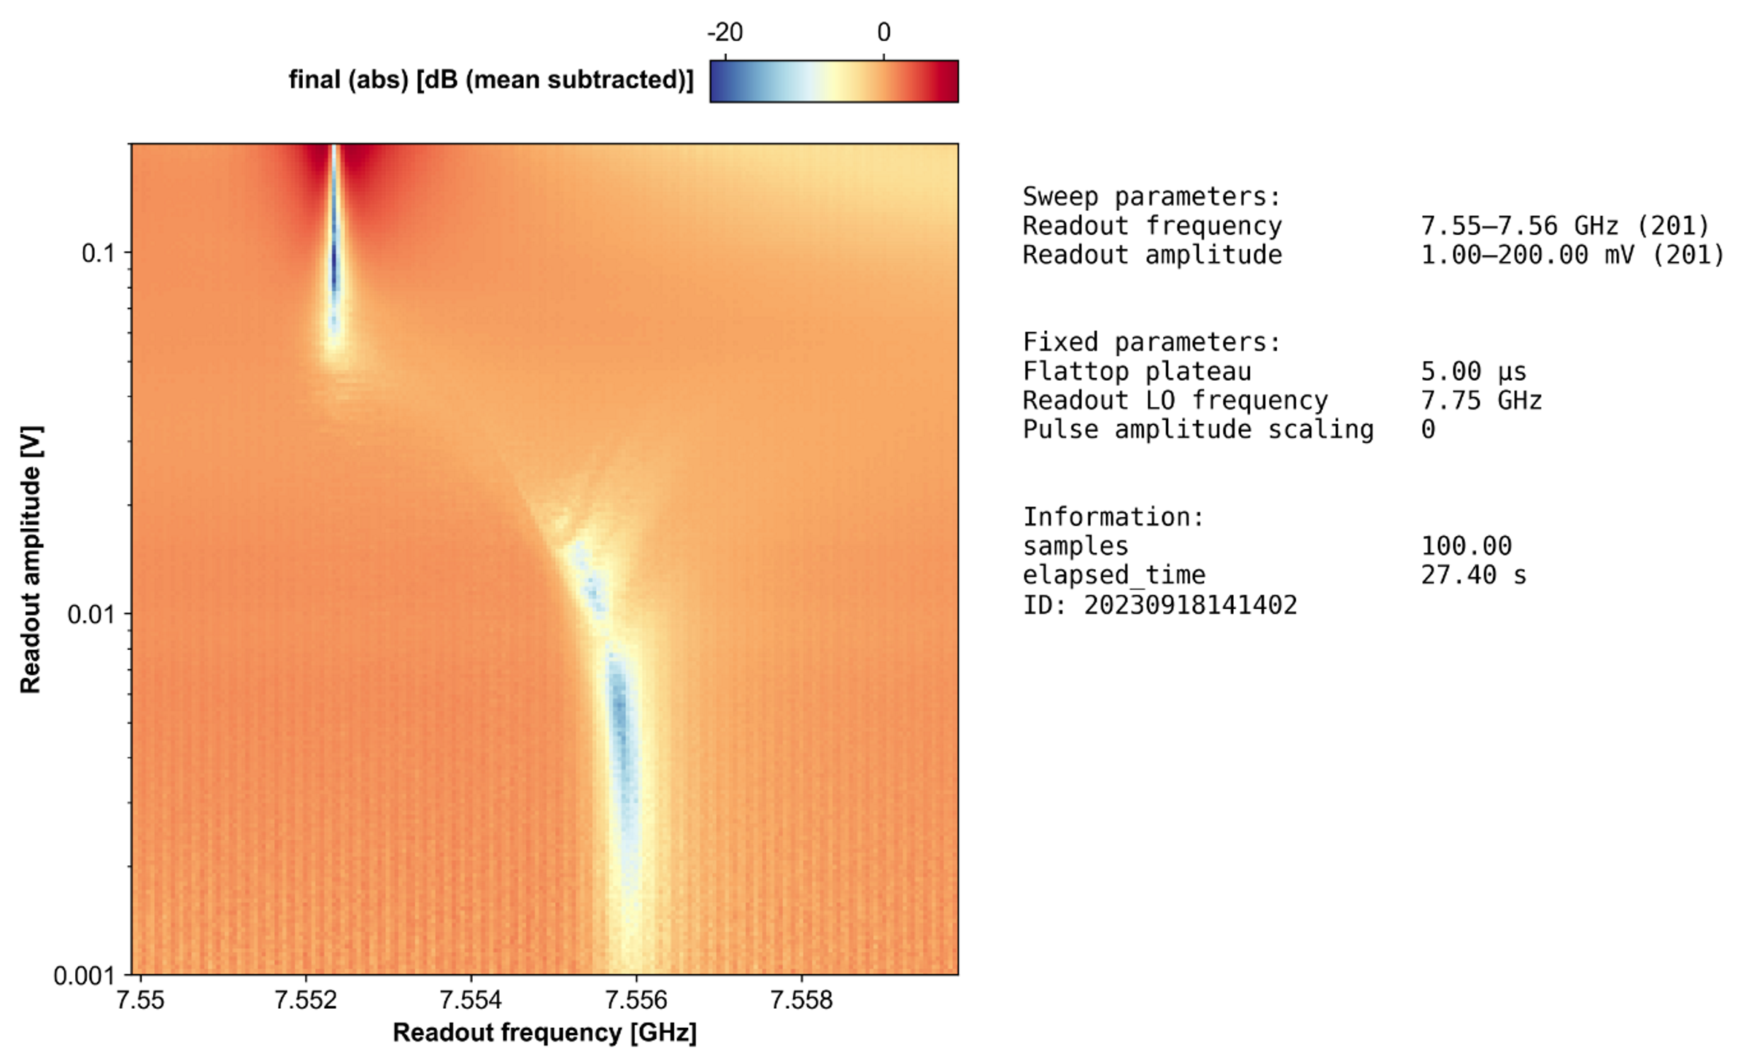
Group Meeting Update 20/9-2023
Octave IQ mixer
Punchout

Slide 2
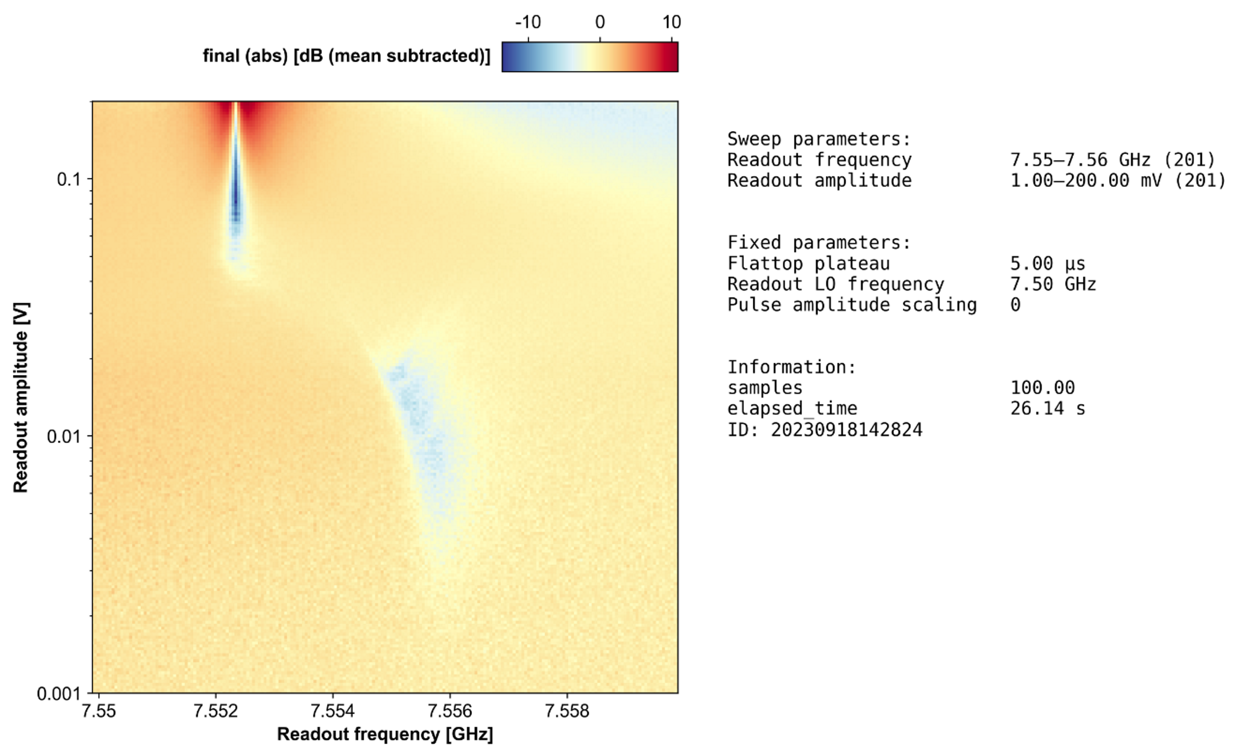
Punchout

Slide 3
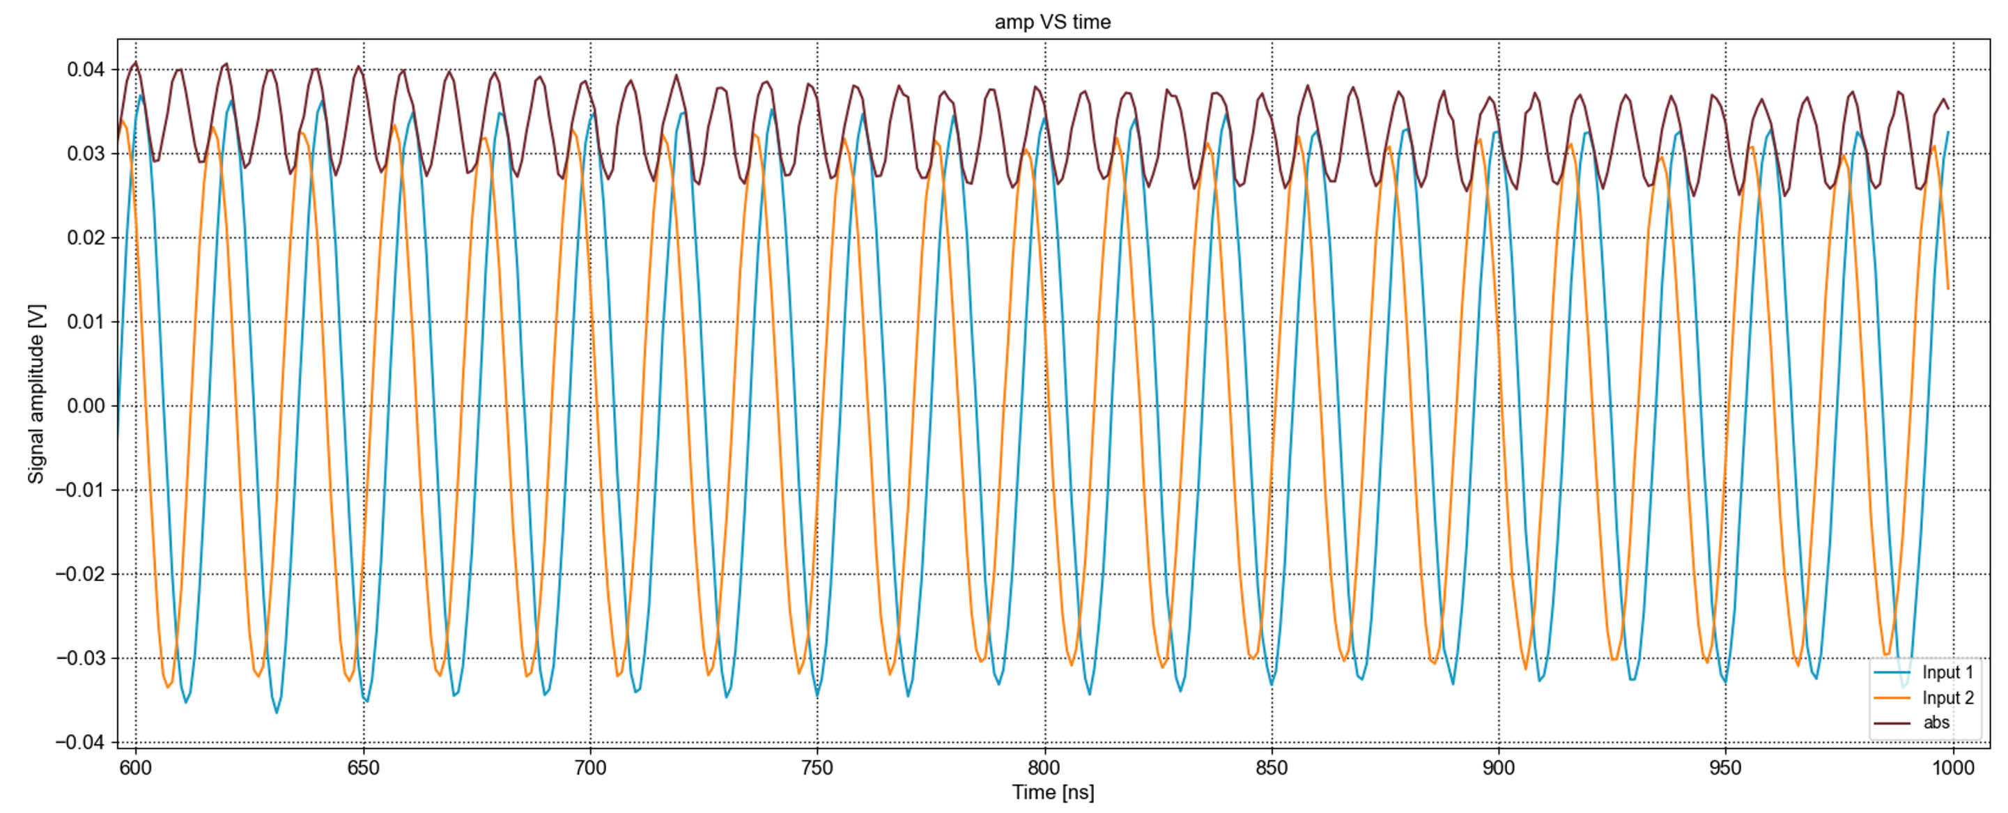
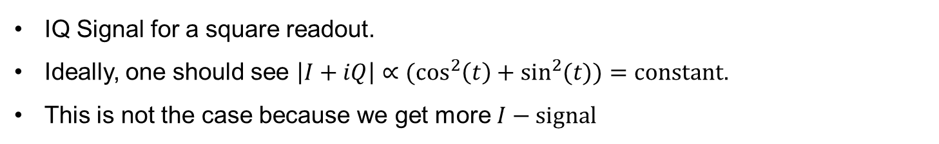
I/Q difference
IQ Signal for a square readout.
Ideally, one should see $\left|I+iQ\right|∝(\cos^{2}\left(t\right)+\sin^{2}(t))=constant$.
This is not the case because we get more $I−signal$

Slide 4
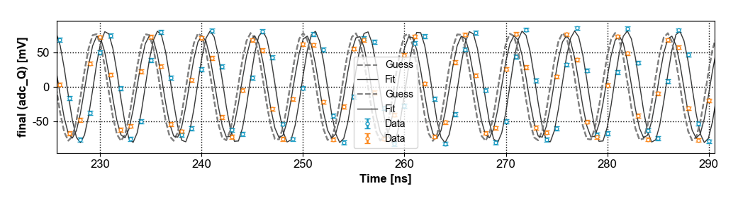
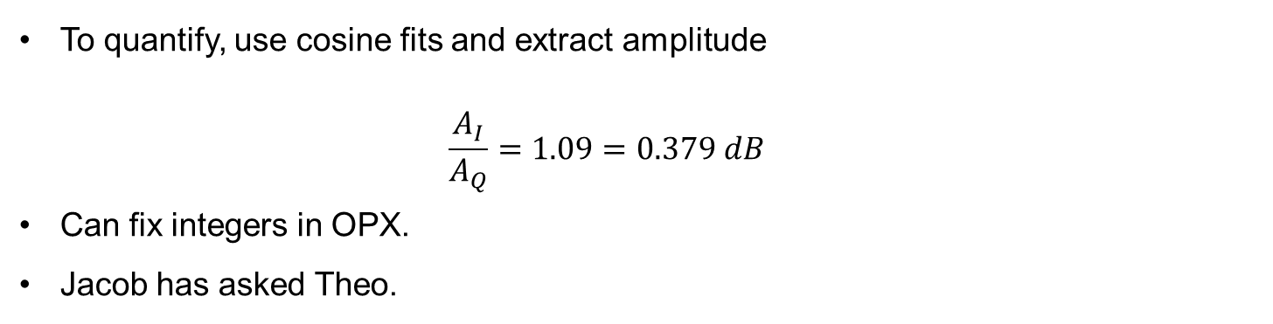
I/Q difference
To quantify, use cosine fits and extract amplitude
$$\frac{A_{I}}{A_{Q}}=1.09=0.379 dB$$
Can fix integers in OPX.
Jacob has asked Theo.

